Slide 1
Recommender Systems
Dr Milan Joshi

Slide 2
Content
Introduction to Recommender System
Non-Personalised Recommender Systems
Introduction to Non-Personalised Recommender Systems
Hacker News Case Study
Lab-Non-Personalised Recommendation System for Movie lens Rating Dataset
Personalized Recommender Systems
Introduction to Collaborative Filtering
Basics of User Based Collaborative Filtering
Steps for User Based Nearest Neighbor Collaborative Filtering
User Based Collaborative Filtering from scratch
User Based Collaborative Filtering using Surprise Library

Slide 3
Content
Item Based Collaborative Filtering
Scalability Challenge for User Based Collaborative Filtering
Steps for Item Based Nearest Neighbour Collaborative Filtering
Implementation for Item Based Collaborative Filtering
Matrix Factorization Based Collaborative Filtering
Motivation and Intuition behind matrix factorization for recommender systems
Rating Prediction using Matrix Factorization with SVD
Funk-SVD
Matrix factorization Based Collaborative Filtering using Surprise
Quiz: Matrix factorization Based Collaborative Filtering using Surprise
Pros and Cons for Collaborative Filtering Methods

Slide 4
Content
Evaluation Metrics
Evaluation of Recommender Systems and its difficulties
Predictive & Classification Accuracy Metrics
Rank Aware Metrics
Implementation of Evaluation metrics in Python
Content Based Filtering
Introduction to Content Based Filtering
Steps for building content based recommender systems
Content based recommender systems for free text item descriptions
Finding Similar Movies using content in Python
Content Based Recommenders using TFIDF

Slide 5
Content
Knowledge Based & Hybrid Recommenders
Introduction to Knowledge Based Recommender Systems
Case Based vs Constraint Based Recommender Systems
Hybrid Recommender Systems

Slide 6
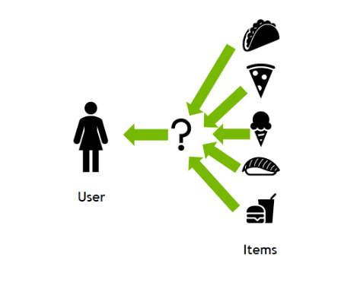
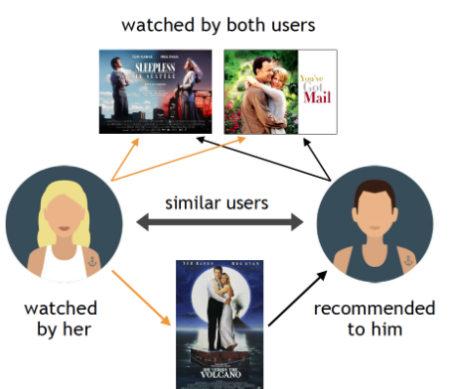
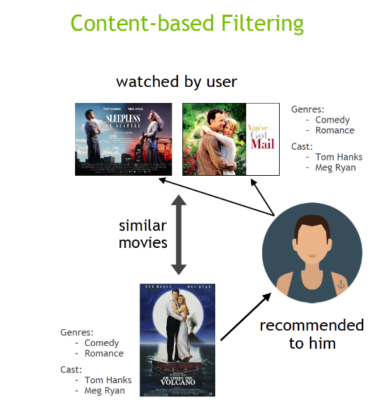
Recommender System
A recommender system is a type of software or algorithm that helps users discover items they might like from a large pool of options.
It makes suggestions based on different types of data, aiming to provide personalized or relevant recommendations to the users.

Slide 7
Non Personalized Recommendation
Promote items that are relevant to the current season, holidays, or special events.
Display the best-selling items to all customers
Showcase new arrivals
Highlight items that are currently trending based on recent sales data.
Curate a selection of items recommended by the store's staff or experts.
Create bundles of popular items or complementary products to encourage customers to purchase more.
Run time-limited promotions on popular or seasonal items to create urgency.
Random Recommendations

Slide 8
Personalized Recommender Systems
popularity-based recommender system
A popularity-based recommender system is a type of recommendation engine that suggests items to users based solely on how popular they are among all users.
It doesn't personalize the recommendations based on a specific user's preferences or past behavior; instead, it recommends the most popular items to everyone, assuming that items liked by many users are likely to be of interest to others as well.

Slide 9
Example:
Let's assume you're building a movie recommendation system. A popularity-based system might work as follows:
The system collects data on how many people have watched or rated each movie.
The top movies based on the number of views or high ratings might be:
Movie A: 10 million views, average rating: 8.5
Movie B: 8 million views, average rating: 8.0
Movie C: 7 million views, average rating: 7.5
The system recommends Movie A, Movie B, and Movie C to all users, regardless of their individual tastes.

Slide 10
Cold Start Problem
The cold start problem refers to the difficulty that recommendation systems face when they don't have enough data to make accurate or personalized recommendations.
This can happen either when the system is new and there is limited data or when new users or items are introduced.
The system cannot effectively match users to items if it has no information about their preferences or the items' attributes.

Slide 11
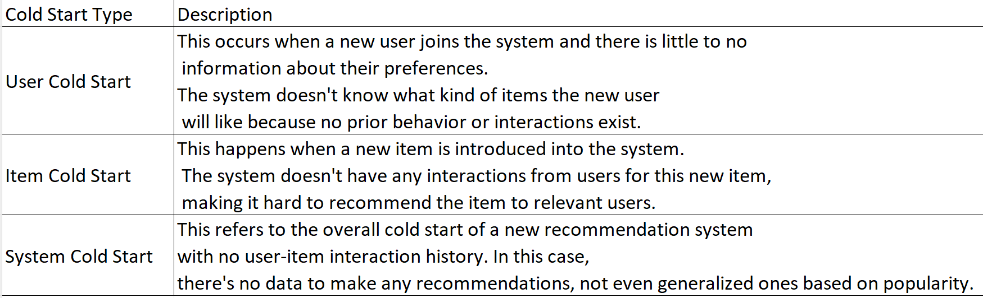

Slide 12
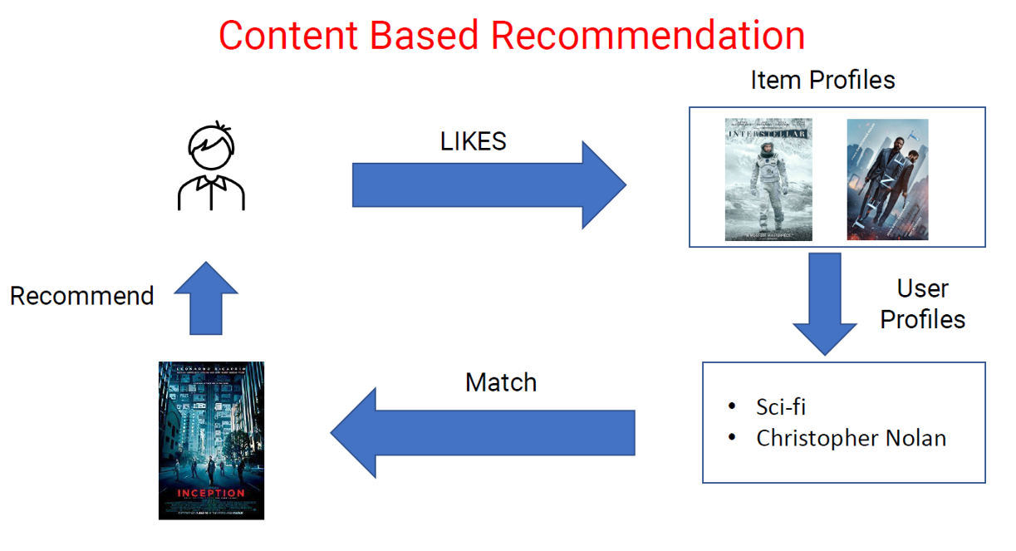
Personalized Recommender Systems

Slide 13
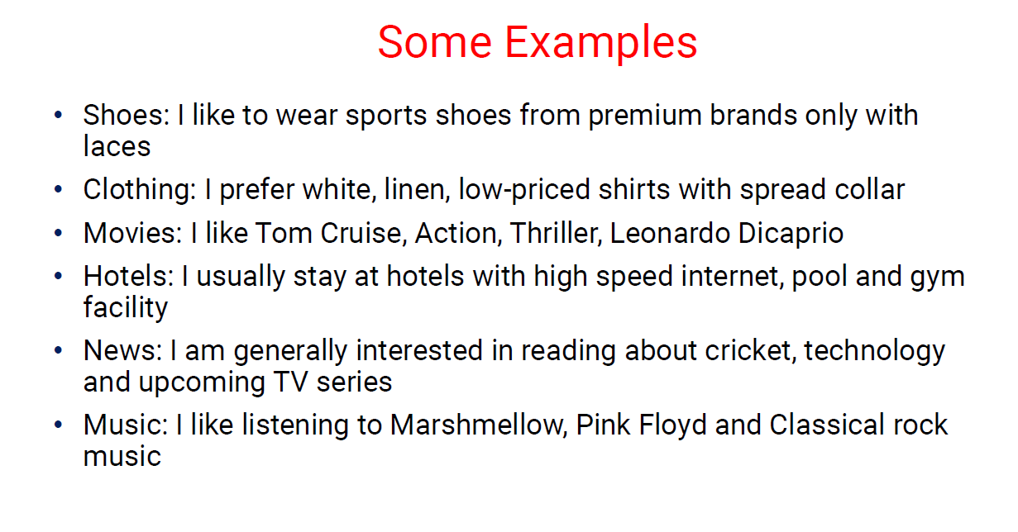

Slide 14
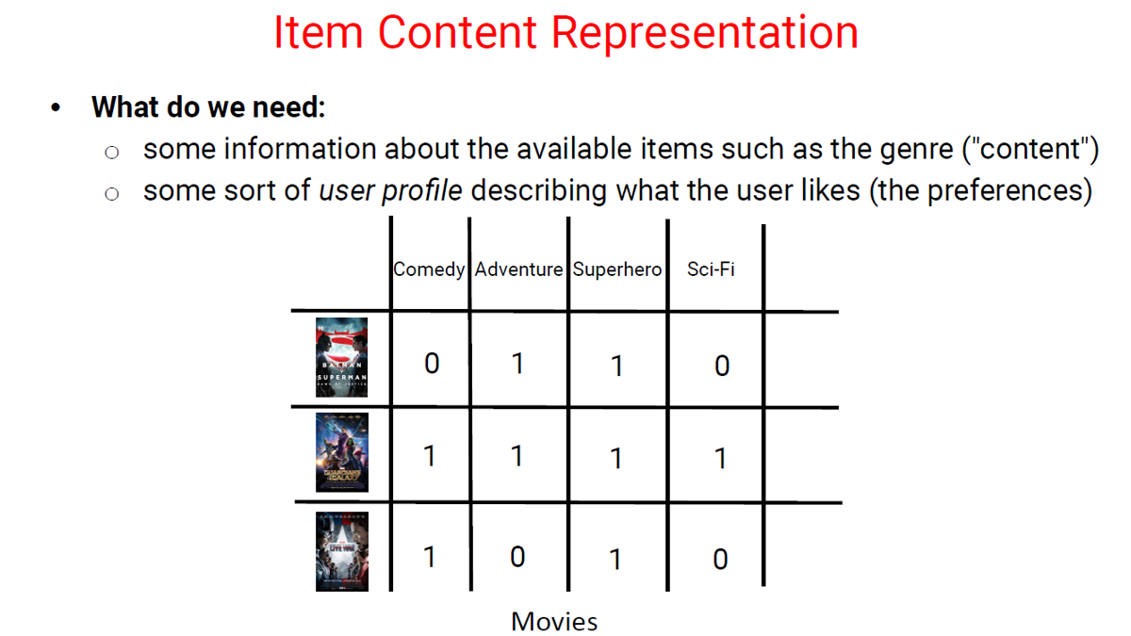

Slide 15
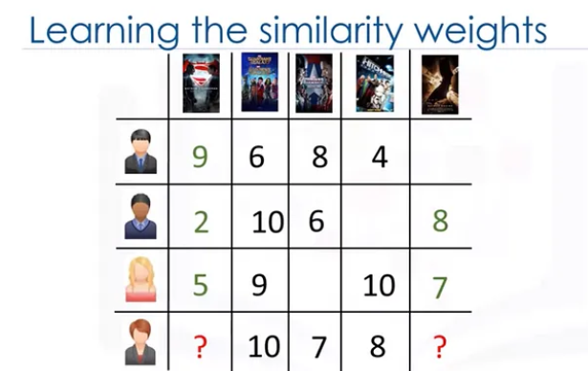
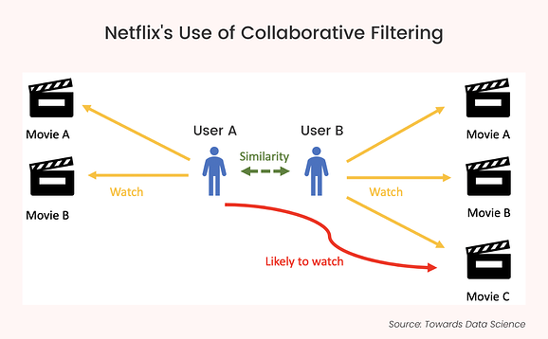
User Based Collaborative Filtering
User-Based Collaborative Filtering (UBCF) is a popular recommendation algorithm used to suggest items to users based on the preferences of similar users.
The underlying assumption is that if users have agreed in the past, they will agree again in the future.

Slide 16
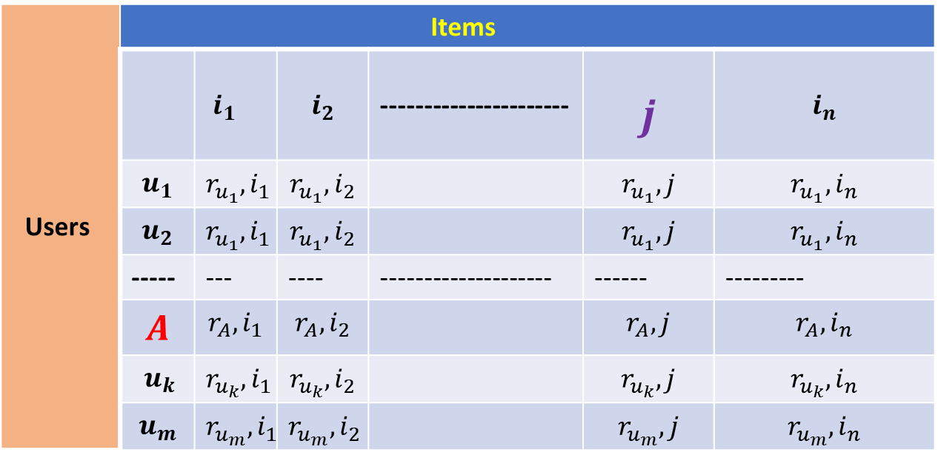
user-based collaborative filtering
In user-based collaborative filtering, our objective is to recommend an item or predict the rating for item 𝑗 for a given user 𝐴 based on the preferences and ratings of the top 𝑁 users who are most similar to user 𝐴.
Users | Items
 |  | $i_{1}$ | $$i_{2}$$ | ---------------------- | $$j$$ | $$i_{n}$$
 | $$u_{1}$$ | $$r_{u_{1}},i_{1}$$ | $$r_{u_{1}},i_{2}$$ |  | $$r_{u_{1}},j$$ | $$r_{u_{1}},i_{n}$$
 | $$u_{2}$$ | $$r_{u_{1}},i_{1}$$ | $$r_{u_{1}},i_{2}$$ |  | $$r_{u_{1}},j$$ | $$r_{u_{1}},i_{n}$$
 | ----- | --- | ---- | -------------------- | ------ | ---------
 | $$A$$ | $$r_{A},i_{1}$$ | $$r_{A},i_{2}$$ |  | $$r_{A},j$$ | $$r_{A},i_{n}$$
 | $u_{k}$ | $$r_{u_{k}},i_{1}$$ | $$r_{u_{k}},i_{2}$$ |  | $$r_{u_{k}},j$$ | $$r_{u_{k}},i_{n}$$
 | $$u_{m}$$ | $$r_{u_{m}},i_{1}$$ | $$r_{u_{m}},i_{2}$$ |  | $$r_{u_{m}},j$$ | $$r_{u_{m}},i_{n}$$

Slide 17

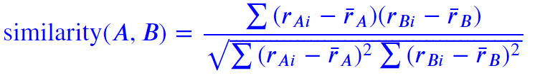
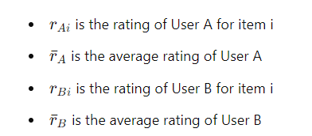

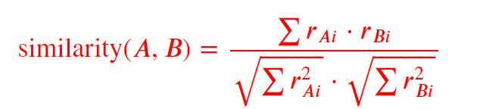
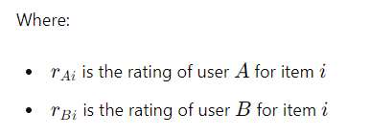
Similarity Measure

Slide 18

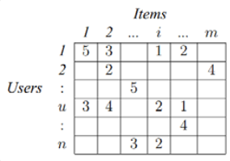


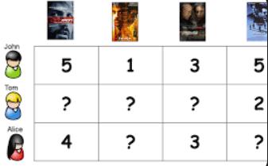
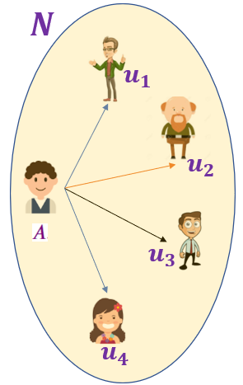
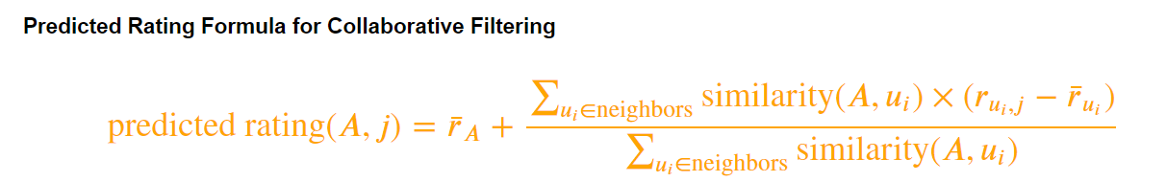
User Based Collaborative Filtering
Stored as
Similarity Calculation
Identify the "neighborhood" of similar users for each user.
Select the top N users with the highest similarity scores to the target user
users' interactions with items (e.g., ratings, clicks, purchases).
user-item interaction matrix where
rows represent users, columns represent items, and the entries represent interactions (e.g., ratings).

Slide 19


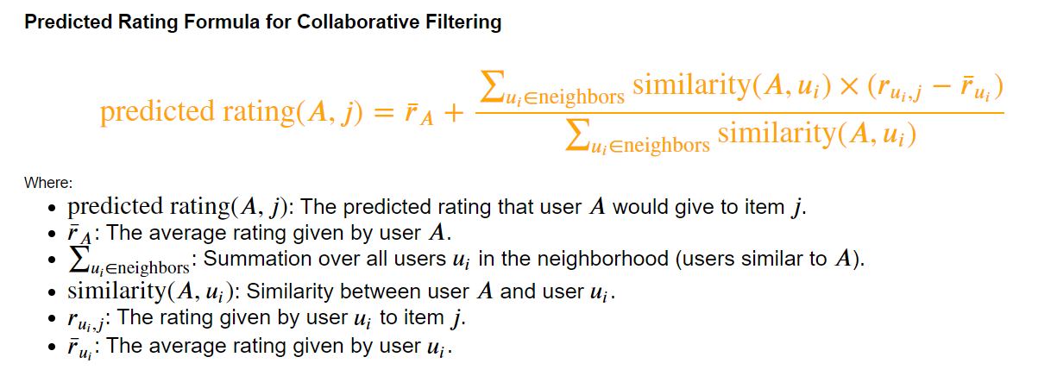










User Based Collaborative Filtering
$$N$$
$$i$$
$$u_{1}$$
$$u_{2}$$
$$u_{3}$$
$$u_{4}$$

Slide 20
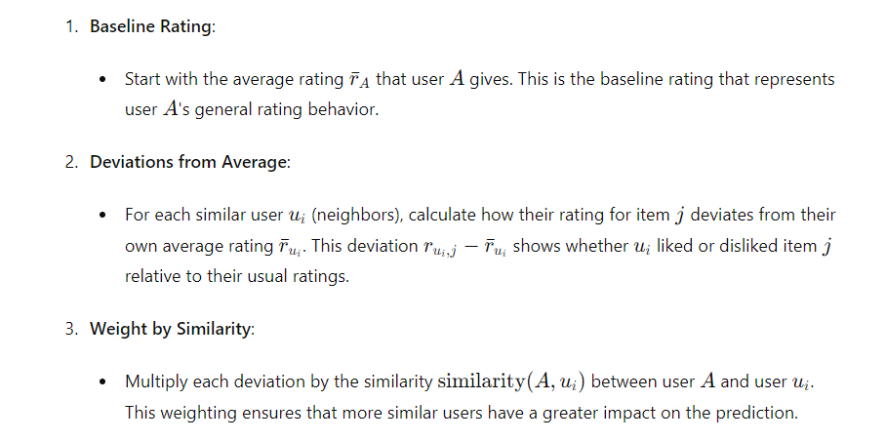
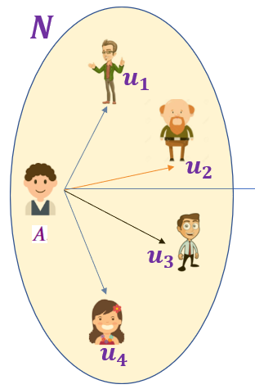

Slide 21
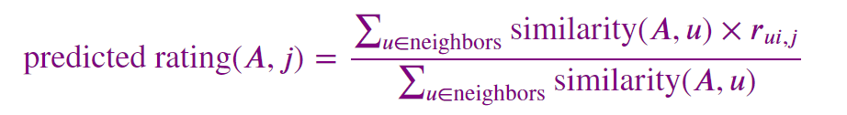
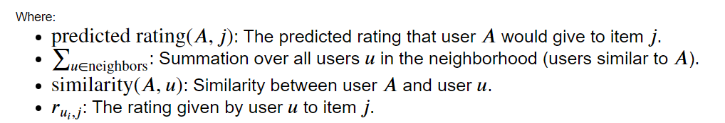

User Based Collaborative Filtering
$$N$$
$$u_{1}$$
$$i$$
$$u_{2}$$
$$u_{3}$$
$$u_{4}$$

Slide 22
Item-Based Collaborative Filtering
In Item-Based Collaborative Filtering, given user 𝐴, we predict their rating for item 𝑗 by computing the similarity between item 𝑗 and other items that user 𝐴 has rated.
We then consider the top similar items (neighbors of 𝑗) and use these items' ratings, weighted by their similarity to 𝑗, to predict the rating for item 𝑗.

Slide 23
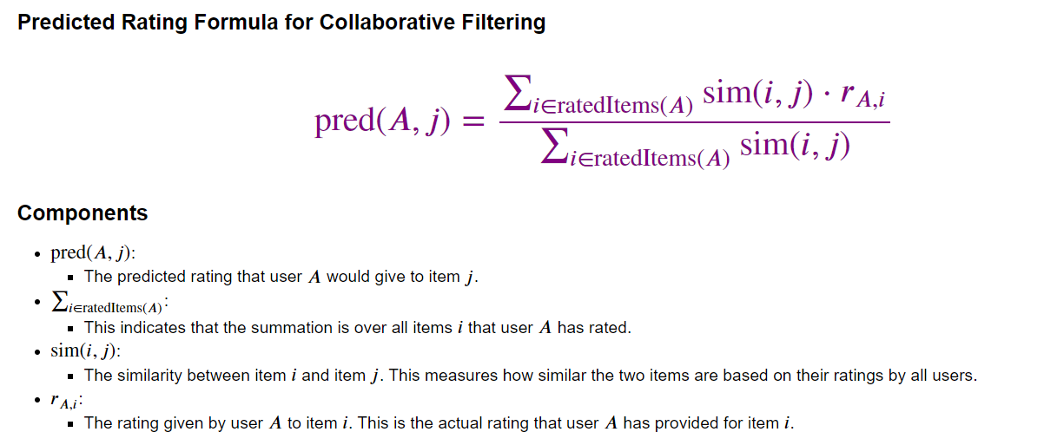
Item Based Collaborative Filtering

